Slide 1

CMPN 425 PHP
Cairo University
Faculty of Engineering
Computer Engineering Department

Slide 2
Three-Tier Architectures
Most web database applications bring together the Web and databases through three layers:
At the base of an application is the database tier, consisting of the database management system that manages the database containing the data users create, delete, modify, and query.
Built on top of the database tier is the complex middle tier, which contains most of the application logic and communicates data between the other tiers.
On top is the client tier, usually web browser software that interacts with the application.

Slide 3
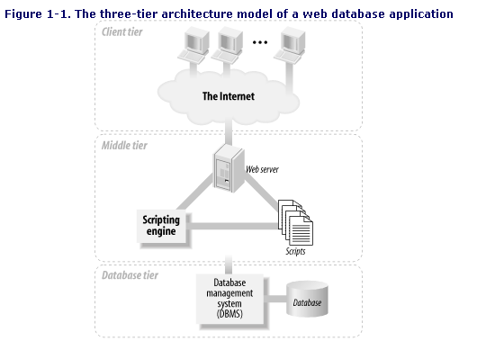
Notes:
Middle Tier (Application Layer/Business Logic Layer):
- This layer contains the web server and the scripting engine.
- The web server is responsible for handling HTTP requests from the client tier, processing those requests, and then sending back the appropriate responses.
- The scripting engine is used to run scripts, which are programs or a set of instructions executed on the server side. These scripts contain the business logic of the application, which can include processing data, interacting with the database tier, and controlling the application's behavior.

Slide 4
The PHP scripting language is used as the middle-tier scripting language.
PHP has emerged as a component of many medium- and large-scale web database applications.
PHP runs on various platforms (Windows, Linux, Unix, Mac OS X, etc.)
PHP is compatible with almost all servers used today
PHP supports a wide range of databases
PHP is free.
PHP is easy to learn and runs efficiently on the server side
Why?

Slide 5
Introducing PHP
PHP (recursive acronym for PHP: Hypertext Preprocessor)
A widely-used open source general-purpose scripting language that is especially suited for web development
Can be embedded into HTML
What distinguishes PHP from something like client-side JavaScript is that the code is executed on the server, generating HTML which is then sent to the client (the browser)

Slide 6
JS VS. PHP
JavaScript traditionally runs client-side, meaning in the user's browser. Therefore it's excellent at things like validating forms, showing/hiding elements dynamically and animations.
PHP, on the other hand, is strictly server-side. PHP is usually used in combination with a database like MySQL to store and edit user and site data.

Slide 7
Getting Started With PHP
How to run a PHP program in XAMPP Server
http://www.tutorialspoint.com/shorttutorials/run-a-php-program-in-xampp-server
Assume you installed xampp in C Drive. Go to: C:\xampp\htdocs
Create your own folder and place in it your php programs
Type localhost on your browser
Notes:
- Open XAMPP control panel
- Next to the Apache name you will find “Config” option, click on it and click on “Apache (httpd.conf)”
- In the text file, search for DocumentRoot
- Next to DocumentRoot, type the directory that contains your php files between double quotations. Example: DocumentRoot "D:\Computer System Consultation\src\php“ (mind how you use forward/backward slashes for the path, backward slash is typically used for Windows)
- Under DocumentRoot, you will find <Directory>, write the same path in it. Example: <Directory "D:\Computer System Consultation\src\php">
- Save the file and close it.
- Run Apache (click start)
- Type localhost/test.php to run a php file called “test.php”

Slide 8
Basic PHP Syntax
The begin and end script tags are <?php and ?> or, more simply, just <? and ?>.
The longer begin tag style <?php avoids conflicts with other processing instructions that can be used in HTML.
Other begin and end tag styles can also be configured, such as the HTML style that is used with JavaScript or other embedded scripts: <script language="PHP"> and </script>.

Slide 9
Basic PHP Syntax
PHP statements end with a semicolon (;)
Comments:
// This is a single-line comment
# This is also a single-line comment
/* This is a multiple-lines comment block that spans over multiple lines */
White space has no effect (PHP ignores whitespace).
→Example 2.1

Slide 10
Notes on PHP
All keywords (e.g. if, else, while, echo, etc.), classes, functions, and user-defined functions are NOT case-sensitive.
However; all variable names are case-sensitive.
The freedom to interleave any number of scripts with HTML is one of the most powerful features of PHP.
→ Example 2.2

Slide 11
PHP Variables
A variable starts with the $ sign, followed by the name of the variable.
When you assign a text value to a variable, put quotes around the value: $txt = "Hello world!";
PHP has no command for declaring a variable. It is created the moment you first assign a value to it.
We did not have to tell PHP which data type the variable is→PHP automatically converts the variable to the correct data type, depending on its value.

Slide 12
PHP Variables
Rules for PHP variables:
A variable starts with the $ sign, followed by the name of the variable
A variable name must start with a letter or the underscore character
A variable name cannot start with a number
A variable name can only contain alpha-numeric characters and underscores (A-z, 0-9, and _ )
Variable names are case-sensitive ($age and $AGE are two different variables)

Slide 13
PHP Variables
PHP has three different variable scopes:
Local
Global
Static

Slide 14
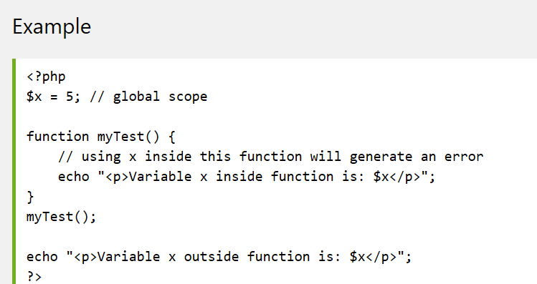
PHP Variables: Global
A variable declared outside a function has a GLOBAL SCOPE and can only be accessed outside a function:

Slide 15
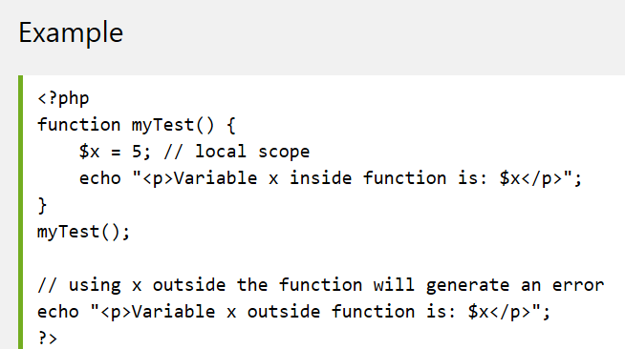
PHP Variables: Local
A variable declared within a function has a LOCAL SCOPE and can only be accessed within that function:

Slide 16
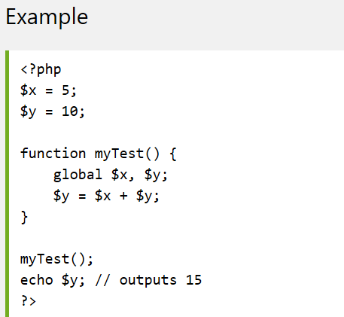
PHP Variables: Global keyword
The global keyword is used to access a global variable from within a function:

Slide 17
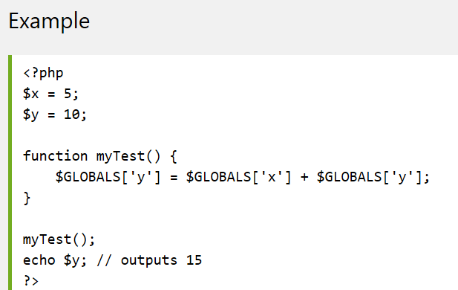
PHP Variables: GLOBALS
PHP also stores all global variables in an array called $GLOBALS[index].
The index holds the name of the variable.
This array is also accessible from within functions and can be used to update global variables directly:

Slide 18
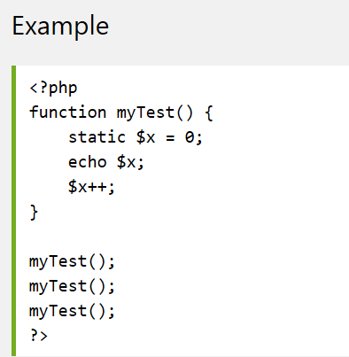
PHP Variables: Static
Normally, when a function is completed/executed, all of its variables are deleted. However, sometimes we want a local variable NOT to be deleted. We need it for a further job.
To do this, use the static keyword when you first declare the variable:
Each time the function is called, that variable will still have the information it contained from the last time the function was called.

Slide 19
PHP Data Types
PHP supports the following data types:
String
Integer
Float (floating point numbers - also called double)
Boolean

Slide 20
PHP Data Types
A string can be any text inside quotes. You can use single or double quotes.
If double quotation marks are needed as part of a string, the easiest approach is to switch to the single-quotation style:
echo 'This works';
echo "just like this.";
There are functions to manipulate strings e.g.:strlen()
The PHP var_dump() function returns the data type and value:
$x = 5985; var_dump($x); →int(5985)

Slide 21
Output Variables
PHP echo and print Statements:
Both are used to output data to the screen.
Both can be used with or without parentheses.
The differences are small:
echo has no return value while print has a return value of 1 so it can be used in expressions.
echo can take multiple parameters (although such usage is rare) while print can take one argument.
echo is marginally faster than print.
Parentheses make no difference to the behavior of print. However, when they are used with echo, only one output parameter can be provided.
There is also a shortcut that can output data. The following very short script outputs the value of the variable $temp:
<?=$temp; ?>

Slide 22
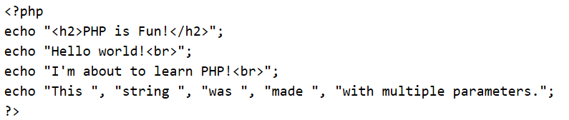
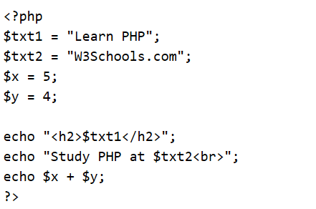
Output Variables
The following example shows how to output text with the echo command (notice that the text can contain HTML markup):
The following example shows how to output text and variables with the echo statement:

Slide 23
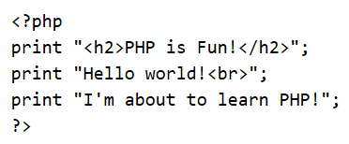
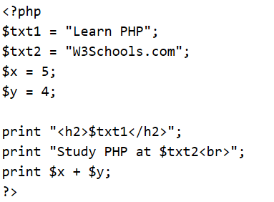
Output Variables
The following example shows how to output text with the print command (notice that the text can contain HTML markup):
The following example shows how to output text and variables with the print statement:

Slide 24
PHP Constants
The value cannot be changed during the script.
Unlike variables, constants are automatically global across the entire script.
Syntax: define(name, value, case-insensitive)
name: Specifies the name of the constant
value: Specifies the value of the constant
case-insensitive: Specifies whether the constant name should be case-insensitive. Default is false
Example:
<?php define("GREETING", "Welcome to W3Schools.com!"); echo GREETING; ?>

Slide 25
PHP Operators
Operators are used to perform operations on variables and values.
PHP divides the operators in the following groups:
Arithmetic operators
Assignment operators
Comparison operators
Increment/Decrement operators
Logical operators
String operators
Array operators

Slide 26
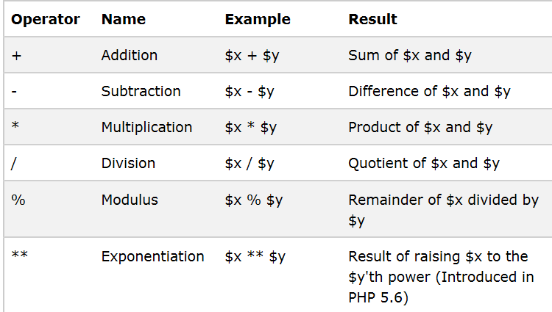
Arithmetic Operators

Slide 27
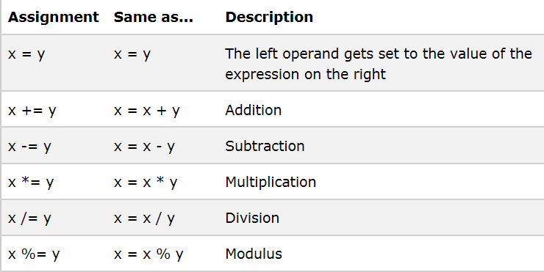
Assignment Operators

Slide 28
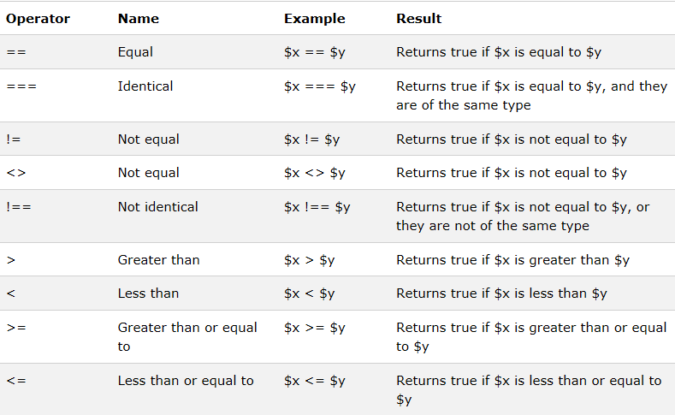
Comparison Operators

Slide 29
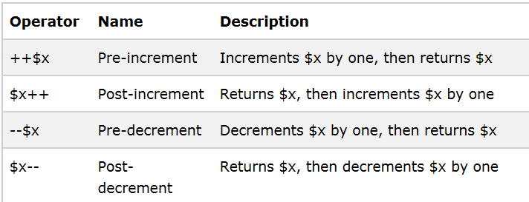
Increment/Decrement Operators

Slide 30
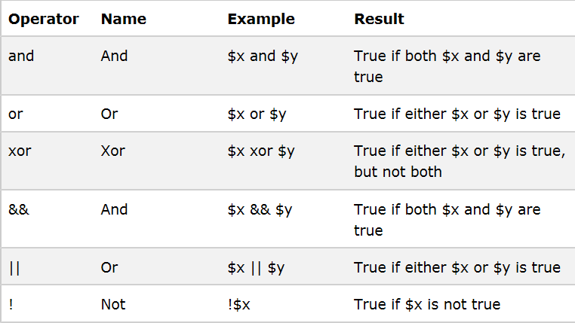
Logical Operators

Slide 31
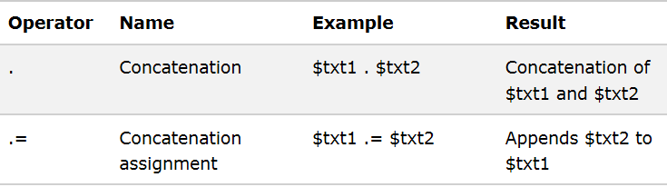
String Operators

Slide 32
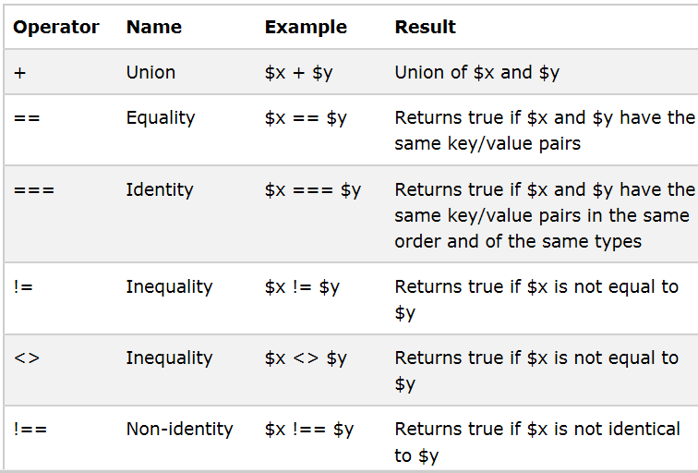
Array Operators
Notes:
it appends elements from the right-hand array to the left-hand array while preserving the original keys. If an element from the right-hand array has the same key as an element from the left-hand array, the element from the left-hand array will be used, and the matching key from the right-hand array will be ignored.
$array1 = ['a' => 1, 'b' => 2];
$array2 = ['b' => 3, 'c' => 4];
$result = $array1 + $array2;
$result will be the following:
Array
(
[a] => 1
[b] => 2
[c] => 4
)
If you use the + operator on two arrays that contain only values (indexed arrays), the result will still be a union of the two arrays. However, because the arrays are indexed, the keys are integers and the keys from the left-hand array will take precedence over the keys from the right-hand array.
$array1 = [1, 2, 3];
$array2 = [4, 5, 6];
$result = $array1 + $array2;
$result will be the following:
Array
(
[0] => 1
[1] => 2
[2] => 3
)

Slide 33
PHP Objects
PHP support object-oriented programming and allows programmers to define their own classes and create object instances of those classes.
A class defines a compound data structure made up of member variables and a set of functions that operate with the specific structure.
To use the data structures and functions defined in a class, an instance of the class—an object— needs to be created.
Objects are created using the new operator.
$aCounter = new Counter;
→Example 2.8
Notes:
In PHP, class members (properties and methods) are public by default.

Slide 34
PHP Objects
Inheritance:
Inheritance allows a new class to be defined by extending the capabilities of an existing base class.
PHP allows a new class to be created by extending an existing class with the extends keyword.
→Example 2.9
Notes:
In PHP, the -> symbol is known as the object operator. This operator is used when you want to call a method or access a data member.

Slide 35
PHP Conditional Statements
if (condition) { code to be executed if condition is true; } elseif (condition) { code to be executed if condition is true; } else { code to be executed if condition is false; }
switch (n) { case label1: code to be executed if n=label1; break; case label2: code to be executed if n=label2; break; case label3: code to be executed if n=label3; break; ... default: code to be executed if n is different from all labels; }

Slide 36
PHP Loops
In PHP, we have the following looping statements:
while - loops through a block of code as long as the specified condition is true
do...while - loops through a block of code once, and then repeats the loop as long as the specified condition is true
for - loops through a block of code a specified number of times
foreach - loops through a block of code for each element in an array

Slide 37
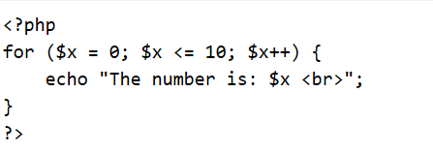
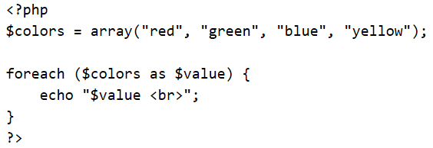
PHP Loops
For loop example that displays the numbers from 0 to 10:
For each:
foreach ($array as $value) { code to be executed;}
For every loop iteration, the value of the current array element is assigned to $value and the array pointer is moved by one, until it reaches the last array element.
The following example demonstrates a loop that will output the values of the given array ($colors):
→Example 2.3

Slide 38
PHP Arrays
In PHP, there are three types of arrays:
Indexed arrays - Arrays with a numeric index
Associative arrays - Arrays with named keys
Multidimensional arrays - Arrays containing one or more arrays
The values that can be stored in a single PHP array don't have to be of the same type; PHP arrays can contain heterogeneous values.

Slide 39
Indexed Arrays
$cars = array("Volvo", "BMW", "Toyota");
$cars[0] = "Volvo"; $cars[1] = "BMW"; $cars[2] = "Toyota";

Slide 40
Associative Arrays
Associative arrays are arrays that use named keys that you assign to them.
$age = array("Peter"=>"35", "Ben"=>"37", "Joe"=>"43");
$age['Peter'] = "35"; $age['Ben'] = "37"; $age['Joe'] = "43";
To loop through and print all the values of an associative array, you could use a foreach loop, like this:
foreach($age as $x => $x_value) { echo "Key=" . $x . ", Value=" . $x_value; echo "<br>";

Slide 41
Multidimensional Arrays
Arrays can also hold other arrays creating multidimensional arrays.
→Example 2.4

Slide 42
Array Functions
count( ) -returns the number of elements in the array.
sort() - sort arrays in ascending order
rsort() - sort arrays in descending order
asort() - sort associative arrays in ascending order, according to the value
ksort() - sort associative arrays in ascending order, according to the key
arsort() - sort associative arrays in descending order, according to the value
krsort() - sort associative arrays in descending order, according to the key

Slide 43
User-Defined Functions
Syntax:
function functionName() { code to be executed; }
A function name can start with a letter or underscore (not a number).
Function names are NOT case-sensitive.

Slide 44
PHP Function Arguments
function familyName($fname) { echo "$fname Refsnes.<br>"; } familyName("Jani");
function setHeight($minheight = 50) { echo "The height is : $minheight <br>"; } setHeight(); // will use the default value of 50
function sum($x, $y) { $z = $x + $y; return $z; } echo "5 + 10 = " . sum(5, 10) . "<br>";

Slide 45
How Variables Are Passed to Functions
By default, variables are passed to functions by value, not by reference.
function doublevalue($var)
{
$var = $var * 2;
}
$variable = 5;
doublevalue($variable);
echo "\$variable is: $variable";
$variable is: 5

Slide 46
How Variables Are Passed to Functions
An alternative to returning a result or using a global variable is to pass a reference (using &$var in the declaration) to a variable as an argument to the function. This means that any changes to the variable within the function affect the original variable.
function doublevalue(&$var)
{
$var = $var * 2;
}
$variable = 5;
doublevalue($variable);
echo "\$variable is: $variable";
?>
$variable is: 10

Slide 47
PHP $_POST Function
The built-in $_POST function is used to collect values from a form sent with method="post".
Example: The example below contains an HTML form with two input fields and a submit button:
<html> <body>
<form action="welcome.php" method="post"> Name: <input type="text" name="fname" /> Age: <input type="text" name="age" /> <input type="submit" /> </form>
</body> </html>
When a user fills out the form above and click on the submit button,
the form data is sent to a PHP file, called "welcome.php“
The URL looks like http://www.anyweb.com/welcome.php
Notes:
The form's action attribute specifies the filename "welcome.php" without a full URL, which means the form data will be sent to "welcome.php" located on the same server and in the same directory as the form itself. The browser automatically assumes that the file resides on the current server and in the same directory as the form unless a different path or full URL is specified.
When you don't provide a full URL (i.e., without the http://www.anyweb.com/ part), the path is considered to be relative. In web terms, a relative path is relative to the current page's position within the website's directory structure. If the current page's URL was http://www.anyweb.com/forms/example.php, and the action is set to "welcome.php", then the form data would be submitted to http://www.anyweb.com/forms/welcome.php.
This behavior allows web developers to move their site to a different domain or change the directory structure without having to update the action paths in all their forms, as long as the relative positions of the files remain the same. It also makes it easier to test the site in different environments, like a local development machine versus the production server, without having to change the form's action URL.

Slide 48
PHP $_POST Function
"welcome.php" looks like this:
<html> <body> Welcome <?php echo $_POST["fname"]; ?>!<br /> You are <?php echo $_POST["age"]; ?> years old. </body> </html>
Output could be something like this:
Welcome John! You are 28 years old.

Slide 49
PHP $_GET Function
The built-in $_GET function is used to collect values in a form with method="get“
Information sent from a form with the GET method is visible to everyone (it will be displayed in the browser's address bar) and has limits on the amount of information to send (max. 100 characters).
Example
<form action="welcome.php" method="get"> Name: <input type="text" name="fname" /> Age: <input type="text" name="age" /> <input type="submit" /> </form>
When the user clicks the "Submit" button, the URL sent to the server could look something like this:
http://www.anyweb.com/welcome.php?fname=Peter&age=37

Slide 50
PHP $_GET Function
The "welcome.php" file can now use the $_GET function to collect form data :
Welcome <?php echo $_GET["fname"]; ?>.<br /> You are <?php echo $_GET["age"]; ?> years old!
When not to use method="get"?
1. Should not be used when sending passwords or other sensitive information.
2. Not suitable for large variable values; the value cannot exceed 100 characters.

Slide 51
PHP $_REQUEST Function
The PHP built-in $_REQUEST function contains the contents of both $_GET, $_POST .
The $_REQUEST function can be used to collect form data sent with both the GET and POST methods.
Example
Welcome <?php echo $_REQUEST["fname"]; ?>!<br /> You are <?php echo $_REQUEST["age"]; ?> years old.

Slide 52
Thank you

